Slide 1
SAS Data MANAGEMENT for MCRM
Rune Nordtorp, SAS
Marts 2015

Slide 2
Data Management
The usage of sas data management in mcrm
Agenda for today
An overview of the functionality in play
What is currently setup at MCRM
The documentation you received
A hands-on session where we will look at the how you develop in SAS Data management
Notes:
Covered in detail (with demos) in June 12th Webex.

Slide 3
Data Management
The functionality in play
In MCRM SAS Data management is primarily used for Data governance
Data is governed by the following tools
Dataflux web studio
Data management studio
These tools helps you manage your business rules and get an overview of the source data used in the MCRM solution.
Notes:
Covered in detail (with demos) in June 12th Webex.

Slide 4
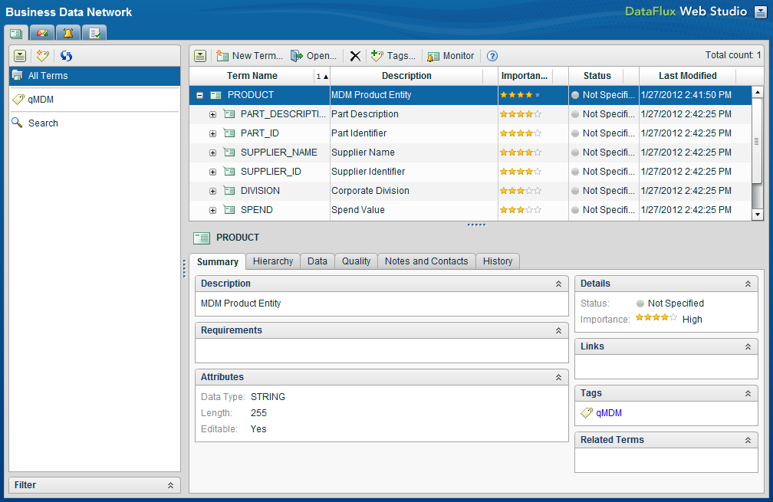
DATA GOVERNANCE FEATURES
Business Data Network
Business Data Network lets business users define terms used throughout the organization and link those terms to data structures, business rules, and other IT objects.
This collaborative environment makes it easy to see relationships across terms and view history of business term modifications.

Slide 5
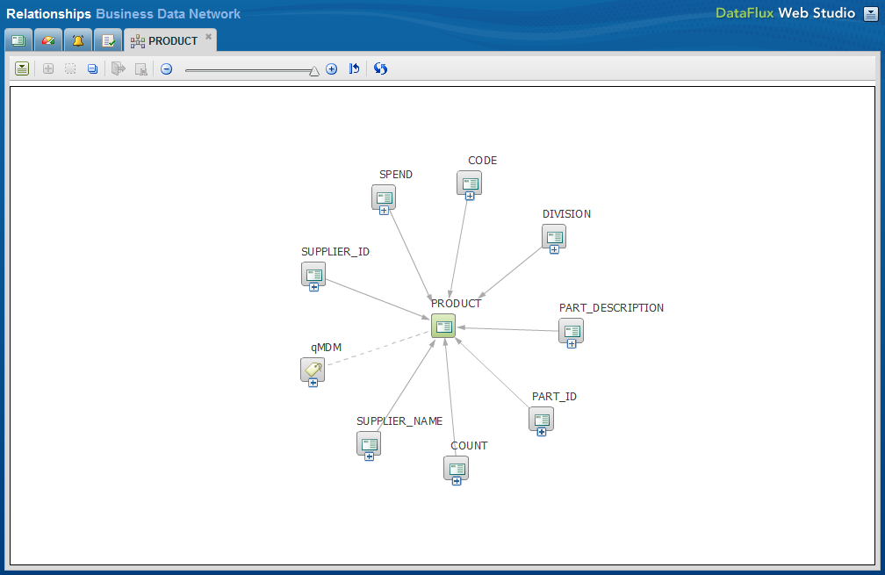
DATA GOVERNANCE FEATURES
Lineage
The lineage of terms managed in Business Data Network and linked to other objects maintained in Reference Data Manager and the rest of the Data Management environment can be shown in the data lineage view of Web Studio.

Slide 6
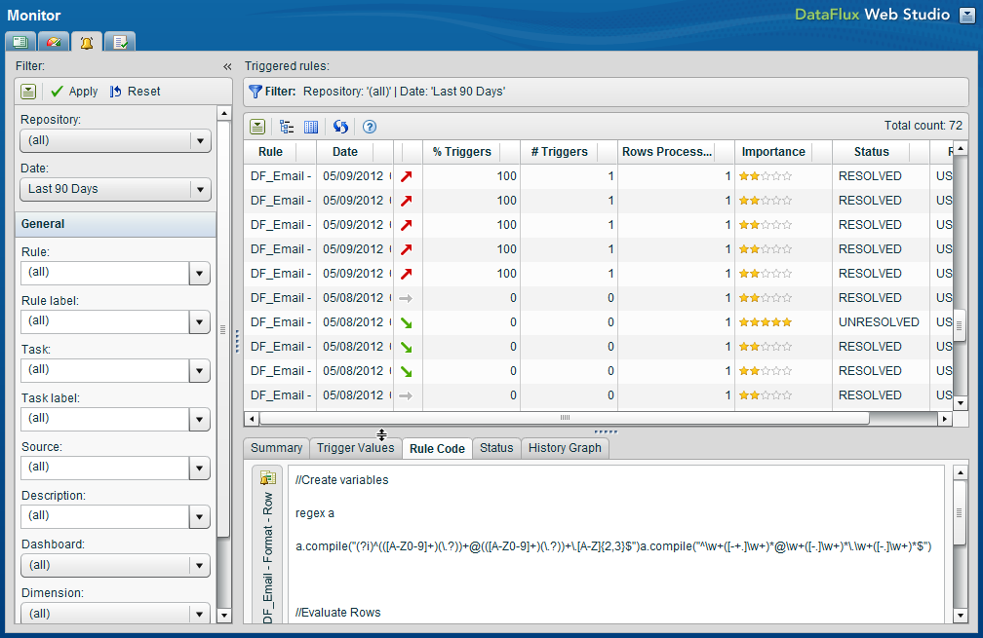
DATA GOVERNANCE FEATURES
Data Monitoring
Data monitoring is native to the SAS DM platform. Because of this, any business rule built into a task in the DM business rule repository can be easily added to any batch job or real-time service.
Violations of business rules found while data is moving through the environment can be displayed to data stewards and others in DM Web Studio where the data that triggered the violation can be evaluated and tracked.

Slide 7
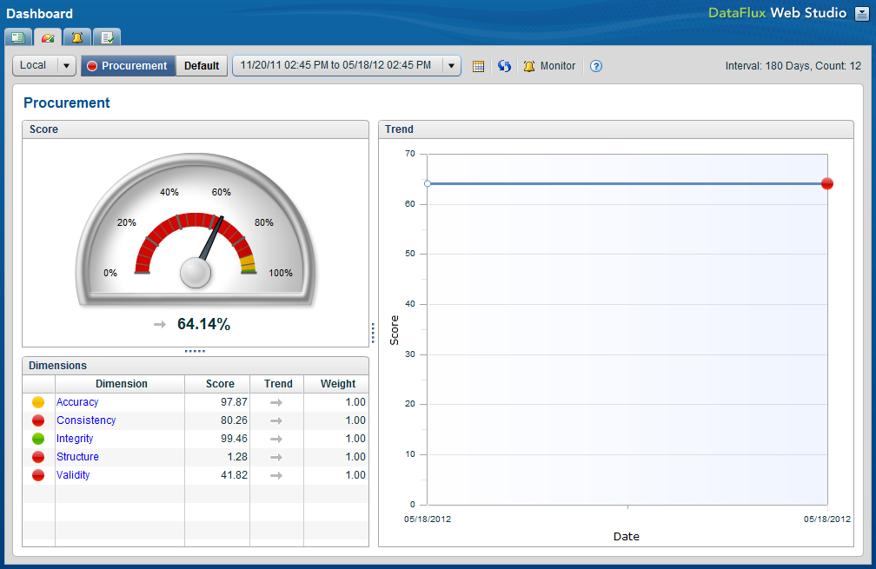
DATA GOVERNANCE FEATURES
Dashboards
SAS DM specific dashboards can be presented to data stewards and others. Using the data quality dimension scoring methodology built into the dashboards, users can keep close track of problem as they arise in real-time.
A low or downward trending score on a key metric may alert data stewards to problematic data in a batch update or a real-time data feed.

Slide 8
Data Management
What is currently setup in mcrm
SAS Data management is setup to monitor varies source systems and is for time being used in the areas:
Structure for
Agreement
Customers
Other (Employees)
History
How many days since the source was updated – before an exception should be triggered.
Varians
To what level must the source vary in size.
Notes:
Covered in detail (with demos) in June 12th Webex.

Slide 9
Thank you

Slide 10
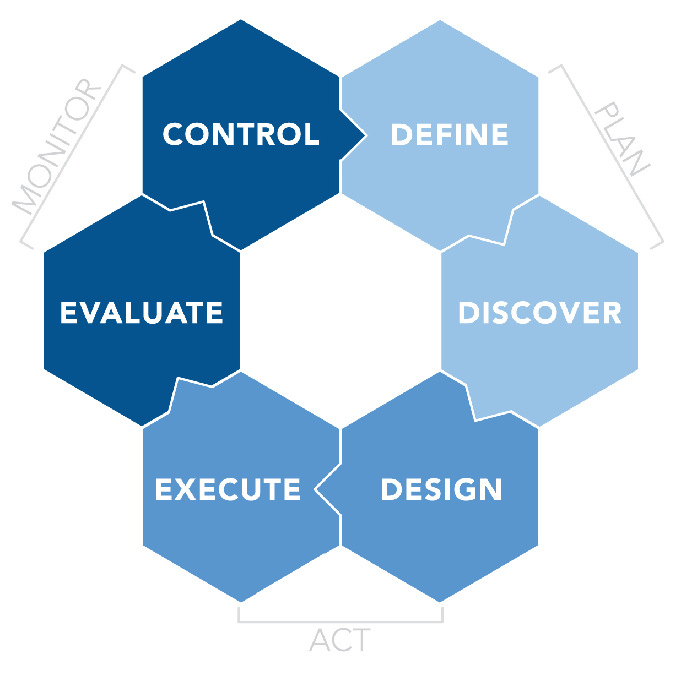
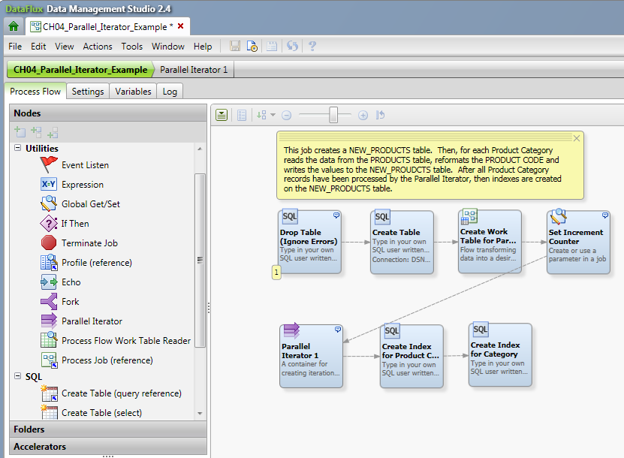
Data Management
PROCESS JOBS, PARELLEL ITERATOR
Process Jobs
More flexiblibity
More Control
Parallel Iterator
Leverage big RAM, multi-core, servers
Faster performance on long-running jobs
Notes:
Covered in detail (with demos) in June 12th Webex.

Slide 11
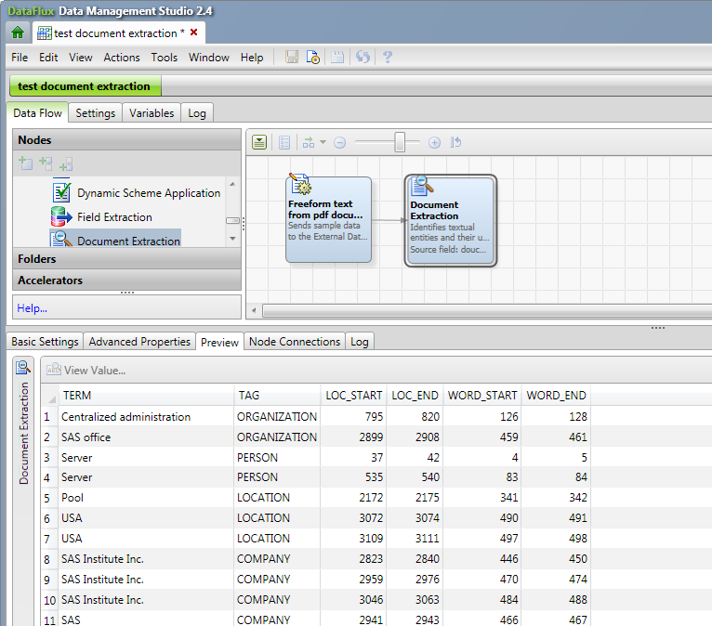
Data Management
UNSTRUCTURED DATA
The “Big Data” explosion is mostly unstructured data
Extract important data from freeform text
Comes with one Contextual Language Pack
Fine tune to include your own business terms, products, etc.
more language packs available as add-on

